Slide 1

What’s important this week

Slide 2
Top Performers
July life case bonus. Qualification period July 1 to July 31, 2026.
Agents qualified
Paid life cases
Bonuses earned
11
47.77
$3,750
New Org agents, PTAS excluded
Credited in the July window
Credited in August through EAP
Bonus doubled to $500
$250 bonus earned
5 or more paid cases and growth over July 2025
3 or more paid life cases in July
1
Finch, Lisa
$500
5
Malone, Brooks
First Prior
4.17 cases
First Prior | 8 cases
6
Randall, Woodrow W
First Prior
4 cases
2
Murry, Tamika
$500
7
Bordelon, Brook
First Prior
3 cases
First Prior | 6 cases
8
Crouch, Casey M
First Prior
3 cases
3
Trepagnier, Harrison A
$500
Second Prior | 5.6 cases
9
Delaughter, Jacob
Current
3 cases
4
Bezou, Rachal
$500
10
Walker, Malika Z
Current
3 cases
Third Prior | 5 cases
11
Winn, Precious R
Current
3 cases
Employee's Whole Life counts 3:1. VUL, Market Wealth Plus and COLI/BOLI excluded. New York State cases and agents not enrolled in EAP by 7/31 receive Council Credits in lieu of cash.
Internal use only. For agent use only. Not for use with the public.
ELEVATE
NEW ORG
Notes:
Open the meeting with this. Say every name out loud and do not rush it.
Eleven agents qualified for the July life case bonus. Forty seven and three quarter paid cases between them, and three thousand seven hundred fifty dollars going out in August.
Start on the left. Four agents doubled the bonus to five hundred dollars. That takes five or more paid cases plus growth over July of last year. Lisa Finch led the office with eight. Tamika Murry had six. Harrison Trepagnier five point six. Rachal Bezou five.
Call out that Harrison is Second Prior and Rachal is Third Prior. They are not brand new and they are still growing year over year. That is what a practice looks like when somebody keeps working the fundamentals after the newness wears off.
On the right, seven agents earned the two hundred fifty dollar bonus with three or more paid cases. Brooks Malone at four point one seven and Woodrow Randall at four were both close to doubling.
Then the three Current Class names. Malika Walker, Precious Winn, and Jacob Delaughter each hit three cases in their first months. Make a point of that. A new agent paying three life cases in a month is doing the job right.
Two housekeeping notes if anyone asks. Employee's Whole Life counts three to one. Variable Universal Life, Market Wealth Plus and COLI slash BOLI do not count, and neither do cases issued in New York State for the cash bonus. Anybody who qualified with New York issued cases, or who was not enrolled in EAP by July thirty first, gets Council Credits instead of cash. Bonuses land in August.
Close by pointing at the number that is missing from this slide. Eleven agents qualified. How many are in this room? The gap between those two numbers is the whole opportunity for August, and the bar was three cases.

Slide 3
Market Week Overview
Week ended Friday, July 31, 2026
Week Ahead: August 3 - August 7, 2026
Internal use only. For agent use only. Not for use with the public.
ELEVATE
NEW ORG
Notes:
This is the transition into the market section. Keep it short.
Frame the two weeks for the room. The week that just ended was the busiest earnings week of the year plus a Fed meeting plus the second quarter GDP report. The week ahead is a labor market week that ends with the July jobs report on Friday.
One sentence to set the table: the market went up last week, but underneath it there was a lot of damage in the AI infrastructure names, and that is the story we will spend the training half hour on.

Slide 4
Week in Review: U.S. Markets Overview
Indexes finished higher while the AI trade churned violently underneath.
S&P 500 closed at 7,489.72 on Friday, up about 1.0% for the week.
Nasdaq Composite closed at 25,373.85, up roughly 1.6% for the week.
Dow closed at 52,485.03, up 276.97 points on Friday and about 1% for the week.
For the month of July: S&P 500 slipped 0.1%, Nasdaq fell 3.2%, and the Dow rose 0.3% for a fourth straight monthly gain.
S&P 500 semiconductors fell 3.4% on the week, per Yardeni Research.
Amazon jumped after earnings beat expectations. Apple fell on soft Services and Greater China revenue.
Plain English
The scoreboard looked calm. The game underneath was not. Big technology earnings pulled the index up while the smaller AI infrastructure names were getting hit hard.
Internal use only. For agent use only. Not for use with the public.
ELEVATE
NEW ORG
Notes:
Start with the scoreboard, then immediately explain why the scoreboard is misleading this week.
Three indexes up about one percent. That is a quiet week on paper. But the S&P 500 has essentially gone sideways since the middle of May, hovering around 7,500, and July finished with the S&P down a tenth of a percent and the Nasdaq down more than three percent.
The point to land: the index level hid a violent rotation. Money moved out of the leveraged, high beta AI infrastructure names and into the large cap technology companies that actually reported cash earnings. Amazon delivered. Apple did not, and got punished for it.
If an agent asks what to tell a client who only reads headlines, the answer is that a flat month with big moves underneath is normal, and it is exactly why we do not build plans around one month of returns.

Slide 5
Key Economic Data Released Last Week
Growth cooled, inflation stayed sticky, and the Fed sat on its hands.
Q2 2026 real GDP
June core inflation
Fed funds decision
1.5%
3.3%
No change
Down from 2.1% in Q1
Still above the Fed's 2% target
Three hawkish dissents
Second quarter GDP grew 1.5%, slower than the first quarter's 2.1%, as tariffs and higher oil prices acted as a supply shock and AI equipment imports widened the trade deficit.
Consumer spending held up. Personal spending rose 2.1% after a 0.4% gain in the first quarter.
The FOMC held rates steady on July 29 with three hawkish dissents. It was Chair Kevin Warsh's first press conference.
NYLIM view
The midyear Macro Pulse calls this The Narrowing Path. Resilient fundamentals and AI leadership, but stickier inflation makes the road ahead narrower.
Internal use only. For agent use only. Not for use with the public.
ELEVATE
NEW ORG
Notes:
Three numbers matter here and you should say all three.
Growth slowed to one and a half percent. That is not a recession, it is a downshift, and the cause is identifiable. Tariffs and the energy shock from the Iran conflict raised costs, and the enormous appetite for AI equipment pulled in imports, which mechanically subtracts from GDP.
Core inflation at three point three percent is the problem. That is well above the Fed's two percent target and it is why the Fed did nothing on the twenty ninth. Three members wanted to hike. That is a hawkish committee.
Consumer spending rose two point one percent. The consumer is still working. That is the piece that keeps this from being a scary picture.
New York Life Investments frames the second half as a narrowing path. Constructive, but with less room for error. That is the house view and it is a good phrase to borrow with clients.

Slide 6
Notable Earnings from Last Week
Big Tech reported together and the market separated spenders from earners.
Capital spending is no longer free. Companies that showed the demand behind the spend were rewarded.
Amazon
Microsoft
Apple
Meta / Alphabet
Beat
Beat
Miss
Punished
Shares surged on the report
Capex guide lifted memory names
Services and Greater China short
Spending without proof of demand
The four hyperscalers are now forecast to spend a combined $720 billion to $745 billion on capital projects in 2026.
About 71% of S&P 500 companies have reported second quarter results. Consensus operating earnings growth was 37.0% year over year as of July 30, though that figure is flattered by mark to market investment gains at a few of the largest names.
Internal use only. For agent use only. Not for use with the public.
ELEVATE
NEW ORG
Notes:
This is the week the market drew a line.
Four of the biggest technology companies reported inside the same week. The ones that showed real demand behind their spending went up. The ones that showed spending without the demand got hit. Amazon and Microsoft were rewarded. Meta and Alphabet were not. Apple missed on Services and on China and fell.
The capital spending number is the one to remember. Somewhere between seven hundred twenty and seven hundred forty five billion dollars from four companies in one year. That is a scale of investment we have not seen before, and the market is now asking a fair question. Where is the revenue?
On the thirty seven percent earnings growth figure, be honest with the room. A chunk of that is mark to market gains on investments, not operating profit. Do not quote it to a client without the caveat.

Slide 7
Economic Reports Calendar: Week Ahead
August 3 to 7, 2026. Labor market week, and Friday is the main event.
Date
Report
Prior / Estimate
Why it matters
Mon 8/3
ISM Manufacturing PMI (July)
Prior 49.0; flash S&P Global 53.8
Above 50 means factories are growing again.
Tue 8/4
JOLTS job openings (June)
Openings expected to soften
Measures demand for workers, not just hiring.
Wed 8/5
ADP private payrolls; ISM Services; Fed speakers Cook and Daly
ADP prior +98,000
First read on July hiring plus Fed tone.
Thu 8/6
Challenger layoffs; jobless claims; Q2 productivity and unit labor costs
Challenger prior 45,800
Labor costs feed directly into inflation.
Fri 8/7
July employment report, 8:30 a.m. ET
June +57,000; consensus about +85,000
The number that sets the September Fed debate.
Rule of thumb: payrolls under 100,000 revives the rate cut case. Over 150,000 pushes yields up.
Internal use only. For agent use only. Not for use with the public.
ELEVATE
NEW ORG
Notes:
Walk the week left to right and do not rush Friday.
Monday is ISM manufacturing. June was 49.0, which means contraction. The private surveys point to a better number. If it prints above 50, factories are growing again and that helps the cyclical parts of the market.
Wednesday gives us ADP payrolls and the service sector reading, plus two Fed speakers. Governor Cook and President Daly did not dissent at the last meeting, so what they say tells us where the middle of the committee sits.
Thursday brings productivity and unit labor costs. Unit labor costs are the quiet inflation number nobody talks about. If labor costs are rising faster than output, inflation gets stickier.
Friday is the whole week. June payrolls came in at fifty seven thousand against a consensus near one hundred fifteen thousand. That was a bad miss, though most of it came from leisure and hospitality shedding sixty one thousand jobs, which looks like a seasonal quirk. Consensus for July is around eighty five thousand.
Give the room the rule of thumb. Under one hundred thousand and the market starts pricing a September rate cut again. Over one hundred fifty thousand and yields go up because the Fed has cover to stay tight.

Slide 8
Earnings Calendar: Week Ahead
Roughly 15% of the S&P 500 reports. The question is whether AI demand is real.
Date
Company
Consensus
Why watch
Mon 8/3
Palantir (PLTR), after close
Rev about $1.81B, up 81%; EPS about $0.35
Software demand, and a 61x sales multiple.
Tue 8/4
Caterpillar, Merck, McDonald's, Pfizer (before open)
Broad old economy read
Industrial and consumer health.
Tue 8/4
AMD (AMC); Amgen; SpaceX first report as a public company
AMD rev about $11.2B, up 46%; EPS about $1.61
MI450 and Helios AI hardware ramp.
Wed 8/5
Eli Lilly, Walt Disney (before open); Shopify; SanDisk
SanDisk is the first pure NAND read
Memory pricing after a 53% drawdown.
Thu 8/6
ConocoPhillips (before open); Rocket Lab
Rocket Lab rev about $155M to $165M
Energy margins and the Iridium deal.
High impact names: Palantir Monday, AMD Tuesday, SanDisk Wednesday. All three are AI demand tests.
Internal use only. For agent use only. Not for use with the public.
ELEVATE
NEW ORG
Notes:
About fifteen percent of the index reports this week, and three of the names are direct tests of the AI trade.
Palantir on Monday is the software test. Revenue is expected to grow eighty one percent, which is remarkable, but the stock trades near sixty one times sales. When a company is priced that richly, beating is not enough. It has to beat and guide higher.
AMD on Tuesday is the hardware test. Revenue expected around eleven point two billion, up forty six percent. The room should listen for the MI450 and Helios ramp, because that is where the Meta and OpenAI commitments turn into revenue.
SanDisk on Wednesday matters more than its size suggests. It is the first clean look at memory pricing after that stock fell fifty three percent from its high. Memory is where the AI supply chain is tightest.
Tuesday morning also gives us Caterpillar, Merck, McDonald's and Pfizer. That is a good cross section of the economy outside technology, and it tells us whether the consumer and the industrial base are holding up.
SpaceX reports as a public company for the first time on Tuesday. Expect noise.

Slide 9
Fed, Rates and Macro Watch
A hawkish committee, a new chair, and an inflation problem that will not quit.
The FOMC held rates steady on July 29. Three members dissented in favor of a hike.
Kevin Warsh chairs the Fed and has declined to offer forward guidance, which puts more weight on every data release.
Ahead of the meeting, CME FedWatch showed roughly a one in three chance of a surprise hike.
The next FOMC meeting is September 16. Friday's jobs report and the August 12 CPI report will decide the debate.
Inflation has been driven higher by energy since the Iran conflict began, which is why easing has been harder to justify.
Advisor angle
Do not sell fear about rates. Sell the plan. When the direction of policy is genuinely uncertain, guarantees, income floors and protection get more valuable, not less.
Internal use only. For agent use only. Not for use with the public.
ELEVATE
NEW ORG
Notes:
The Fed picture changed character this year and agents need to understand why.
For most of the last two years the argument was about how fast the Fed would cut. That argument is over. Three members of this committee voted to raise rates in July. Before the meeting, the futures market put the odds of a surprise hike near one in three.
The reason is energy. The conflict with Iran pushed oil and freight costs up, and that has reversed a lot of the disinflation we had. Core inflation at three point three percent does not let the Fed ease.
Kevin Warsh will not give forward guidance. Whatever you think of that as policy, the practical effect is that every jobs report and every CPI print now moves the market more than it used to, because there is no cushion of guidance to absorb it.
The advisor angle is the part to emphasize. Uncertainty about rates is not a reason to panic a client. It is the argument for the products we sell. Guaranteed income and protection are worth more when nobody can tell you what the next twelve months look like.

Slide 10
Theme Spotlight: The AI Deleveraging
The biggest story of the week was a fund blowing up, not an index moving.
Situational Awareness LP, a $45 billion AI focused hedge fund, was forced to sell its entire public stock portfolio to Ken Griffin's Citadel after margin calls.
This was a rotation, not an AI crash. Money moved out of the leveraged, capital hungry end of AI and into the profitable, asset light end.
AI infrastructure names fell 36% to 55% in July while enterprise software names rose 17% to 37%. The S&P 500 fell only 2.3% and Nvidia finished July higher.
Korea's Kospi lost roughly a third of its value in July, then rose 17.9% on July 31, its largest one day gain on record.
Plain English
One large investor borrowed heavily to bet that AI would destroy software companies. The opposite happened. His lenders made him sell everything at once, and that forced selling drove most of July's swings.
Internal use only. For agent use only. Not for use with the public.
ELEVATE
NEW ORG
Notes:
This is the bridge into today's training, so set it up but do not give away the whole story.
Here is the short version. A twenty five year old former OpenAI researcher named Leopold Aschenbrenner ran a fund called Situational Awareness. It peaked around forty five billion dollars. He borrowed roughly four dollars for every dollar of his own and put it into one idea. Buy the physical build out of AI, and short the software companies he believed AI would destroy.
In July the market did the opposite of what he expected. His AI infrastructure holdings fell thirty six to fifty five percent. The software companies he was short went up seventeen to thirty seven percent. He lost on both sides at once, and his lenders called the loans.
Now say the part that almost everybody got wrong, because it is the whole point of the training. This was not an AI crash. The S and P 500 fell about two percent and Nvidia actually finished July higher. This was a rotation. Money left the leveraged, capital hungry end of AI and moved into the profitable, cash generating end of it.
He was on the wrong side of that rotation on both legs, at four times leverage.
Tell them we will spend the training on why he was wrong, because that is the part that is useful. Leverage only explains how fast it happened.

Slide 11
Client Talking Points: What This Means for You
Plain English language you can use in conversations this week.
What happened last week
What it means for your plan
The stock market finished the week a little higher, and July ended about where it started.
The economy grew more slowly this spring than it did at the start of the year, but people kept spending.
Prices are still rising faster than the Federal Reserve would like, so it left interest rates alone.
One large investment fund got into trouble and had to sell everything it owned. That caused big swings in a small group of technology stocks.
Your plan was not built on one month of returns, and it should not change because of one.
Borrowing money to invest is what turned a bad month into a disaster for that fund. Your plan does not do that.
Owning a mix of things, rather than one idea, is what keeps a rough patch from becoming permanent damage.
Nobody can tell you what interest rates do next. That is exactly why guarantees and protected income are worth having.
If anything in your life has changed, that is a better reason to review your plan than anything in the news.
Internal use only. For agent use only. Not for use with the public.
ELEVATE
NEW ORG
Notes:
This is the client facing slide. Read it the way you would say it at a kitchen table, not the way you would say it on a trading desk.
The goal is not to impress anybody with what you know about hedge funds. The goal is to make a client feel like somebody is paying attention on their behalf.
Four things happened. The market was up slightly. The economy slowed but people kept spending. Inflation is still too high so the Fed did nothing. And one big fund blew itself up with borrowed money and made a handful of technology stocks jump around.
Then pivot to the plan. The single most useful sentence you can say this week is this. That fund did not fail because it was wrong about AI. It failed because it borrowed so much money that it could not afford to wait to be right. Your plan does not borrow. That is on purpose.
Close by asking what has changed in their life. A new job, a new grandchild, a parent who needs care. Those are real reasons to revisit a plan. A headline is not.

Slide 12
New Org: What’s important week of August 3
Notes:
New Org Section: For SPs and Partners presenting to New Org agents. These slides are visible to EPs and MPs.

Slide 13



Target Markets Upcoming Webinars
Date: Monday, August 3, 2026 Time: 4:00 p.m. ET
Chinese Market Monthly SIE Study Group Sessions
Chinese Market will conduct a series of SIE tutorial sessions based on STC study material. All sessions will be conducted primarily in Mandarin Chinese and English.
Scan the QR code to register for Monthly SIE Study Group Sessions
Notes:
Chinese Market Monthly SIE Study Group Sessions
(for New Org, Estab and Second Line Managers)
Chinese Market will conduct a series of SIE tutorial sessions based on STC study material. All sessions will be conducted primarily in Mandarin Chinese and English.
Contact: targetmarkets@newyorklife.com
Register: https://nylife.zoom.us/meeting/register/a4UI1WqPQOKCBm1JCZqQoA
Submitted by: John Macchia

Slide 14
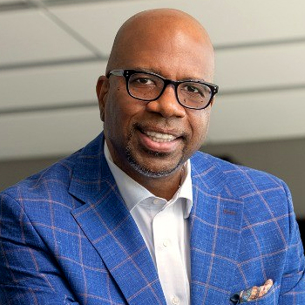
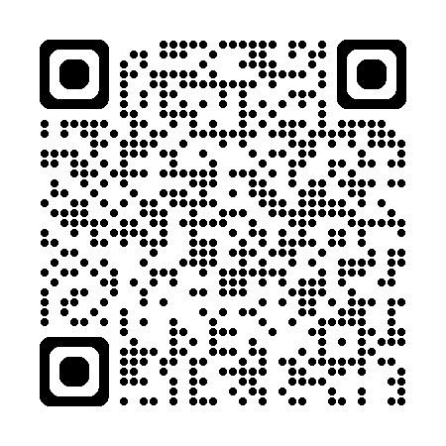
Don’t miss this month’s Motivation Monday!
Register now for insights from Broderick Young
Date: Monday, August 3, 2026
Time: 3:00 – 4:00 p.m. ET*
Featured speaker
Join Broderick Young for a candid conversation on the mindset and relationship-building approach that have shaped his career.
Hosted by Andrew Goldstein, Vice President, Agency Sales & Field Activation
Authenticity, resilience and self-belief
Education and a resource-focused approach
Ideas to strengthen client relationships and drive growth.
Broderick L. Young, CASL, CFP, CLF, ChFC, CLU
Greater DC General Office
Chairman’s Council
Register today - Scan the QR code to reserve your spot today.
*2 pm CT, 1 pm MT, 12 pm PT, 11 am Alaska, 9 am Hawaii
Notes:
Start the week with insights from Broderick Young
Motivation Monday is a monthly webinar series designed to help agents start the week with fresh ideas, practical strategies and motivation from some of New York Life’s most successful professionals. In the Aug. 3 session, hosted by Andrew Goldstein, Vice President, Agency Sales & Field Activation, Broderick Young will share how authenticity, resilience, education and a relationship-focused approach have shaped his New York Life career. Attendees will gain practical insights they can apply to strengthen client connections, reframe conversations and support long-term growth.
Contact: PLAN@newyorklife.com
Registration link: https://nylife.zoom.us/webinar/register/WN_ZjFTU_KiRP-XRXYvkZQ1DA

Slide 15
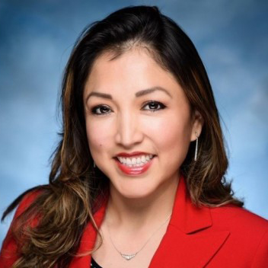
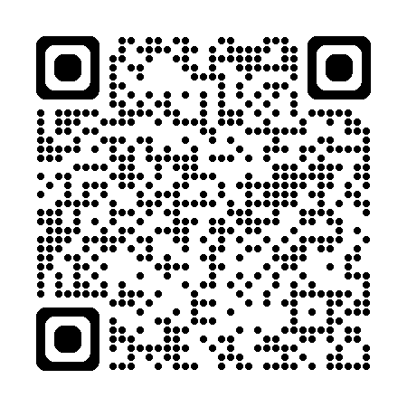
Explore what’s new with SVUL Accumulator II
A national PLAN webinar focused on new riders and new opportunities
Featured speaker
Date: Wednesday, August 5, 2026
Time: 2:00–3:00 p.m. ET*
Learn about upcoming SVUL Accumulator II updates and practical ways to identify and position opportunities with clients.
Overview of SVUL updates
Introduction to the Extended No Lapse Guarantee Rider
Suitability Assist AI chatbot
Latest ClientMine enhancements
Hosted by Palmer Stokes, Variable Universal Life Solutions Consultant
Register today - Scan the QR code to reserve your spot and learn how upcoming SVUL Accumulator II updates can create new opportunities for client conversations.
Evelin Freytas, MBA, LUTCF, CLTC
Chairman’s Council
Chicago North Shore Office
*1 p.m. CT, 12 p.m. MT, 11 a.m. PT, 10 a.m. Alaska, 8 a.m. Hawaii
Notes:
Explore what’s new with SVUL Accumulator II
This national PLAN webinar is designed to help agents understand upcoming SVUL Accumulator II updates and identify new opportunities for client conversations. Attendees will gain practical insights, positioning strategies and resources they can use to strengthen outreach and support meaningful discussions with clients.
Hosted by Palmer Stokes, Variable Universal Life Solutions Consultant, the session will feature Evelin Freytas, Chairman’s Council and the top-selling SVUL agent year-to-date. The webinar will cover the new Extended No Lapse Guarantee Rider, expanded lapse protection, client profiles and ways to position SVUL in practice. Agents will also learn about the Suitability Assist AI chatbot and the latest ClientMine enhancements to help identify opportunities, prioritize outreach and guide timely follow-up.
Contact: PLAN@newyorklife.com
Registration link: https://nylife.zoom.us/webinar/register/WN_1OlOlV9VRBC6FWL95OZ9PQ

Slide 16
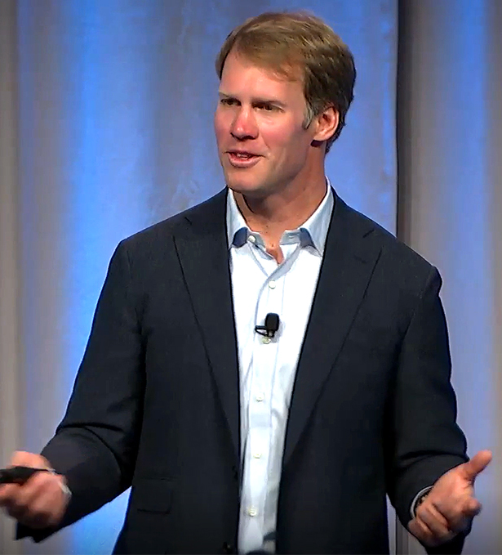
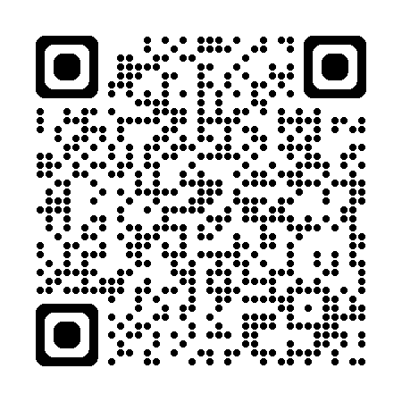
Back by popular demand: Bobby Samuelson
Take a deeper look at how insurance solutions support a holistic financial strategy
Date: Thursday, August 6, 2026 | Time: 2:00 p.m. ET*
Age & Stage Planning: Elevate Your Practice with Purpose
Join Bobby Samuelson for an insightful discussion on how insurance solutions can enhance a holistic approach to your clients' financial strategy.
Understand the value behind different solutions – not just their price.
Learn how to connect insurance recommendations to broader goals.
Empower clients through thoughtful, planning-centered conversations.
Register today - Scan the QR code to reserve your spot for this exclusive session with Bobby Samuelson. Gain practical insights into life insurance product design to support more informed client conversations.
Bobby Samuelson
Editor, The Life Product Review
Respected life insurance industry authority
*1 p.m. CT | 12 p.m. MT | 11 a.m. PT10 a.m. Alaska | 8 a.m. Hawaii
Notes:
Back by popular demand: Bobby Samuelson returns
Bobby Samuelson returns by popular demand for a timely discussion on how insurance solutions can enhance a holistic approach to your clients' financial strategy. This session will highlight key considerations across today’s solutions and offer practical insights agents can use to support more informed client conversations. Scan the QR code to register for the Aug. 6 webinar.
Contact: PLAN@newyorklife.com
Registration link: https://nylife.zoom.us/webinar/register/WN_DIfKj2pjQAKHI5WPLPGy1A#/registration

Slide 17
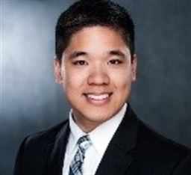
New Agent Educational call
Life Insurance 101 – Term, Whole, Blends and Use Cases
Date: August 12, 2026 Time: 1:00 p.m. ET
Featured speaker
Gain the confidence to explain each option simply and recommend coverage based on client’s goals, budget, and life stage
Use real life planning examples to develop more meaningful client-focused conversations
William J. Louie
Sales Desk Manager
Life and Business Solutions
Scan the QR code to register for this event or webinar.
Notes:
Gain the confidence to explain each option simply and recommend coverage based on client’s goals, budget, and life stage
Use real life planning examples to develop more meaningful client-focused conversations

Slide 18
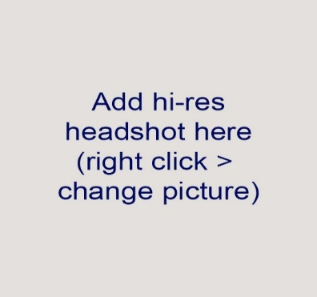

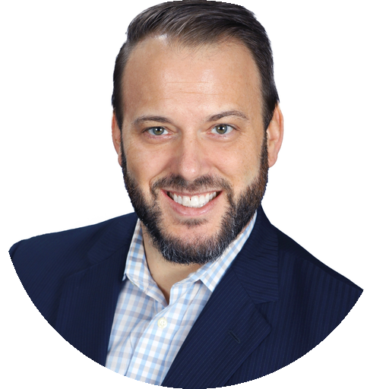
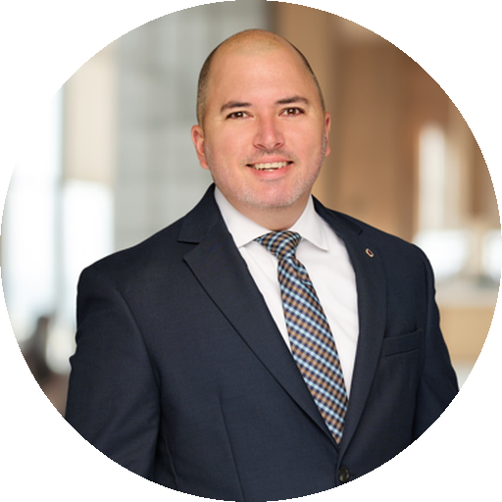
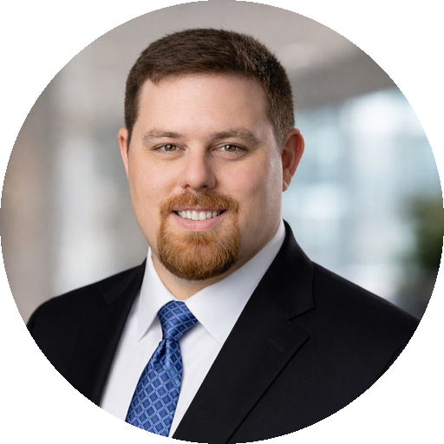
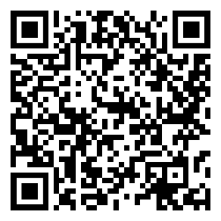
ChatGPT Advantage: Agent insights series
Date: Thursday, August 13, 2026 Time: 2:00 p.m. ET
Featured speakers
Hear directly from financial professionals using ChatGPT successfully — plus experts from OpenAI
Jakob Hart, RICP
Financial Advisor & President Hart and Hart Financial Services Tampa Office
Daniel Lee
Financial Services Professional Registered Representative Central Georgia Office
Paul Holman, ChFC, CLU, FSCP
Financial Advisor Diamond Springs Financial Norfolk Office
Prompting
Custom GPTs
Content
Automation
Research
Data
Add QR code here
Scan the QR code to register for this event or webinar.
Notes:
See real, relevant workflows that help improve efficiency, productivity and the quality of how agents serve clients and grow the business. https://nylife.zoom.us/webinar/register/WN_8sDC4TQSTma5ZcumWO9lJg#/registration

Slide 19

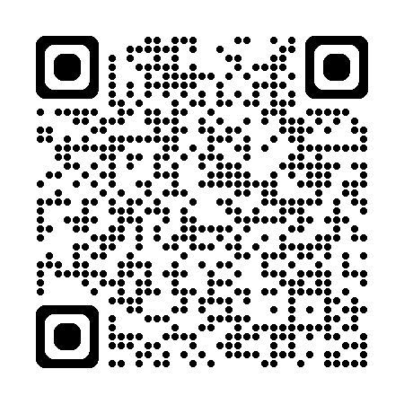
Awards Your Way
A new choice-based incentive program for Council agents
Open to eligible 2026 Council agents, QC and higher¹
Qualification period: July 1–December 31, 2026
Earn points through insurance production, growth, and designations
Choose rewards that fit you, including travel, merchandise, gift cards, tickets, and experiences
Action required: Complete the opt-in survey by September 30, 2026, to participate
Scan the QR code to learn more about Awards Your Way and complete the opt-in survey by September 30, 2026.
¹Agents eligible to enroll in the Life and Annuity Expense Allowance Plan must enroll by July 31, 2026.
Notes:
Contact: PLAN@newyorklife.com
Info Central Page: https://www.today.newyorklife.com/agencyportal/s/article/Awards-Your-Way

Slide 20


Now available on Hearsay/Yext New IDI email & social media campaigns
Ready-to-use individual disability insurance (IDI) tools to help you target and grow your business.
Relevant messaging built for:
Business owners
Young professionals
White-collar clients
White-coat clients
Add QR code here
Scan the QR code to tbrowse and enroll all campaigns
Notes:
Ready-to-use individual disability insurance (IDI) tools to help you target and grow your business.
https://assets.newyorklife.com/is/content/nylAssetsProd/individual-disability-insurance-digital-agent-playbook?uuid=dac6f6f5-4c94-4699-a6dd-e5b9556604c1

Slide 21



Annuity Insights: Women and Wealth Podcast Series
Turn episode insights into client-ready conversations.
This podcast series examines the financial challenges and planning opportunities shaping women's wealth.
Designed to provide discussion prompts, planning ideas, and client-ready resources.
Turn insights into stronger relationships and more impactful planning conversations with women clients.
Scan the QR code to visit the Annuity Insight podcast channel
Notes:
Discover insights that can strengthen client conversations and support better planning outcomes for women.
Visit the Annuity Insight podcast page for episodes and additional information.
Season 1 and 2 currently available
InfoCentral Landing Page: https://www.today.newyorklife.com/agencyportal/s/article/Agency-Podcast-Page

Slide 22
Estab: What’s important week of August 3

Slide 23
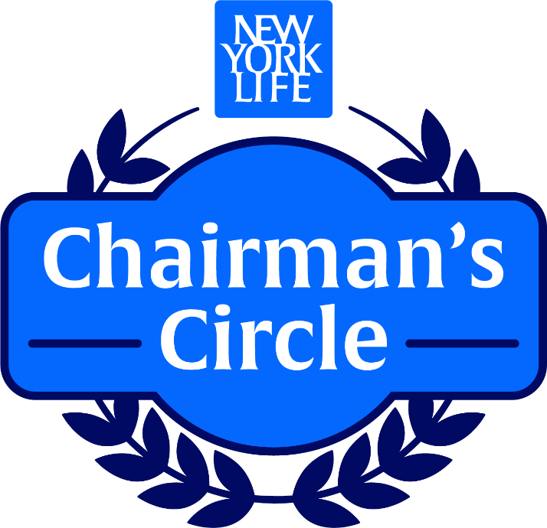


Chairman’s Circle returns for 2H 2026
Help eligible Chairman’s Council agents qualify for an invitation-only Kentucky Derby® experience
What managers need to know
Open to 2026 Chairman’s Council agents
Eligible agents: 2026 Chairman’s Council agents
Qualification period: July 1–December 31, 2026
To qualify, agents must:
Rank in the top 50 on the paid insurance solution premium leaderboard¹
Grow 10% over 2H 2025, with a minimum of $150K
Agents eligible to enroll in the Life and Annuity Expense Allowance Plan must enroll by July 31, 2026.
Be proactive by Dec. 31
Chairman's Circle is off to the races!
Qualifiers will experience one of the world’s most celebrated sporting traditions—the Kentucky Derby® at Churchill Downs.
Ensure eligible agents complete the survey and opt in by Sept. 30!
Scan the QR code to review program details and help your agents prepare on Info Central.
Notes:
Chairman’s Circle returns for 2H 2026!
Chairman’s Circle returns for the second half of 2026, offering eligible Chairman’s Council agents an invitation-only experience to the Kentucky Derby® . Managers should help agents understand the qualification requirements, track progress throughout the July 1–December 31 incentive time period and reinforce the September 30 opt-in deadline. Full program details are available on Info Central.
¹ Includes Life, LTCi, and DI. Recurring base premium and riders are calculated at 100%; OPP and single premium policies are calculated at 10%. Excludes LTCi in Delaware state.
Contact: PLAN@newyorklife.com
Info Central Agent Chairman’s Circle Page: https://www.today.newyorklife.com/agencyportal/s/article/Chairman-s-Circle-2H-2026

Slide 24
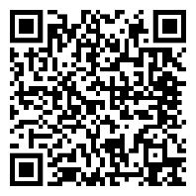
NYL’s Agent Development Program & the Advisor Symposium
Complementary programs designed to help agents work in the advanced markets.
Agent Development Program
The Advisor Symposium
Internal webinars for agents to learn how advanced strategies work for clients and how to propose the techniques to clients’ other financial advisors (COIs).
2026 Topics
Three-hour nationwide turnkey program for agents to host as a networking opportunity with their COIs and other professionals in their community.
Nov. 4 – 2-5 PM Eastern
Wealth Transfer & Income Tax Planning
Aug 5
12-1 PM
Advanced Estate Planning
Sept 2
12-1 PM
Business Succession & Buy-Sell
Oct 14
12-1 PM
Agents host program for their COIs at their own venue.
All promotional & program materials are provided.
CE credits available for attorneys and CPAs.
Watch InfoCentral for more details.
Scan the QR code to sign up for the August 5 webinar
SMRU 8996467.1 Exp. 10/14/2026
Notes:
Agents attend internal webinars to hear from outside professionals how advanced planning topics are applied to common situations in the affluent and high net worth market.
Using that knowledge, they then host the Symposium to build network and increase referrals.
Register for Agent Development webinars at – Share these links to register
https://nylife.zoom.us/webinar/register/WN_zdM0HxoJR1iQv541yJp7HA#/registration – August 5
https://nylife.zoom.us/webinar/register/WN_8DM6JbJeQ1S9OKfxjv4sHg#/registration – Sept 2
https://nylife.zoom.us/webinar/register/WN_wKUcuQL0T62fBk_KRySxzA#/registration – Oct 14
Contact Darla Bean at Darla_bean@newyorklife.com for more information

Slide 25

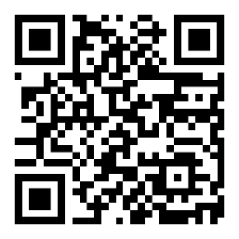
2026 Advisor Symposium – Venue registration is now open!
Register your venue before Aug. 28 to host this year’s event.
Why should agents host the 2026 Advisor Symposium?
The 2026 Advisor Symposium will be held on Nov. 4 from 2 - 5 pm Eastern.
Marketing materials, suggested outreach plans, and hosting / CE instructions will be provided for all registered venues.
CLE, CPE, and American College PRP credits will be offered for qualified attendees.
Attendee registration begins in early September.
Build network of COIs and increase referrals.
Position themselves as trusted source of industry knowledge.
Scan the QR code to register to host the event.
For questions contact: AdvisorSymposium@newyorklife.com
SMRU 9035730 Exp 11/4/2026
Notes:
Register your venue at – https://nyladvisors.com/2026asvenue/
CE credits are offered for attorneys, accountants, and all financial professionals holding designations from The American College.
(The purpose of this program is to build referral networks through hosting an educational event for COIs; as such, no insurance CE is offered.)
Contact Darla Bean at Darla_bean@newyorklife.com for more information

Slide 26


The 2027 Calendar Program is live on Marketing on Demand
Keep your brand in front of your clients 365 days a year.
Printed, personalized calendars your clients hang on their wall, refrigerator, or place on their desk.
Available to order on MOD starting Aug 3.
For calendars to arrive before the end of 2026, order by:
Nov 2 for direct mail calendars
Nov 22 for bulk calendars
Scan to see more detials
Notes:
The Calendar Program has been a staple at New York Life for many years. It is a great way to let your clients know you care, and it keeps your brand in front of them throughout the year.
Easy to order on MOD as your clients are loaded in MOD and updated weekly. You can mail the calendars directly to your clients or have them personalized and shipped to you with envelopes so you can mail on your own, or hand out personally.

Slide 27
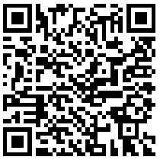
Join Our Upcoming WMCP® Study Cohort
Study cohorts are free of charge and meet weekly for 1 hour.
Kick-Off: Tuesday, September 1, 2026 Time: 4:00 p.m. ET
WMCP® Courses
WMCP 360
Introduction to Goal-Based Planning
WMCP 361
Efficient Investment Portfolios
WMCP 362
Strategic Wealth Management
Eagle-affiliated IARs looking to pursue the Wealth Management Certified Professional® (WMCP®) designation are invited to join one of the upcoming study cohorts.
Tuition is covered*
Earn CE credits**
Study alongside your peers***
Registration closes on August 18. Cohort details and session invitations will be sent August 19.
Study cohort meets Wednesdays from 4pm-5pm ET for 12 weeks starting September 9
Study cohort meets Fridays from 11am-12pm ET for 12 weeks starting September 11
Study cohort meets Tuesdays from 4pm-5pm ET for 12 weeks starting September 8
Scan the QR code to reserve your seat.
Questions? Send an email to:
NYLIC_University@newyorklife.com
*There is no upfront cost for New Org Agents. Established Agents are fully reimbursed upon successful course completion.
**CE credits vary by state. Please contact The American College at CE@theamericancollege.edu for state-specific information.
***Participation in study cohorts is optional. Our team is happy to assist with American College course registration regardless of your approach.
Notes:
Contact: Melli Hase and Sean Gilrein | designations@newyorklife.com
This slide serves as a reminder that study cohorts are available for Agents and Managers currently pursuing, or interested in pursuing, the WMCP® designation. The next cohorts will kick off on Tuesday, September 1, followed by 12 weekly sessions as outlined above.
QR Code link: https://research.newyorklife.com/jfe/form/SV_5BJF32zw0jifZqu

Slide 28


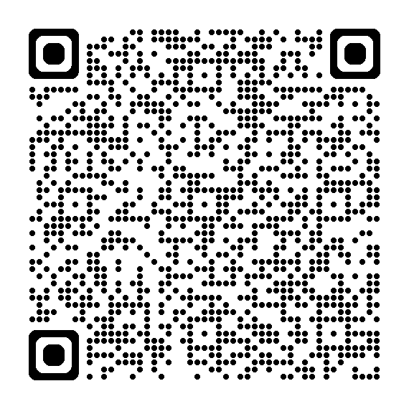

Exclusive Council Perks for EC and PC agents
COUNCIL PERKS
Executive Council Qualifiers
President’s Council Qualifiers
Exclusive invitation to the Rocky Mountain Crocs™ Giveaway Experience, featuring a complimentary Crocs bag, NYL Jibbitz™ charm and 2 additional charms.
Highlights
Top 200 paid insurance solution cases¹ leaderboard
Qualification period: July 1 – August 14
Must attend Executive Council meeting
Registered guests welcome
Enjoy a private shopping event with a retail credit² to spend at select resort boutiques when you qualify for the President’s Council Beachfront Boutique Experience.
Highlights
Top 100 paid insurance solution premium³ leaderboard
Qualification period: July 1 – September 30
Must attend President's Council meeting
Top 10 get a premium Balinese-inspired chickee beach hut rental
Registered guests welcome
Scan the QR code for complete Executive Council incentive details on Info Central.
Scan the QR code for complete President’s Council incentive details on Info Central.
Notes:
¹ Executive Council Rocky Mountain Crocs Giveaway: Includes Life (EWL 3:1) LTCi, and DI. Excludes VUL/Market Wealth Plus, Annuity and COLI/BOLI products, DIOP and Group Insurance cases. LTCi excluded in Delaware State.
² President’s Council Beachfront Boutique Experience: $300 retail credit
³ President’s Council Beachfront Boutique Experience: Includes Life, LTCi, and DI. Recurring base premium and riders are calculated at 100%; OPP and single premium policies are calculated at 10%.Excludes premium from Annuity and COLI/BOLI products, DIOP and Group Insurance cases and LTC in DE state.
=============================================================
Exclusive Council Perks for EC and PC agents
Executive Council Rocky Mountain Crocs™ Giveaway Experience – Open to 2026 Executive Council qualifiers.
Compete with your Executive Council peers from July 1 through August 14.
Agents who finish in the top 200 on the paid insurance solution cases leaderboard will qualify for an exclusive invitation for themselves and their registered guests to the Rocky Mountain Crocs Giveaway Experience at the Executive Council Meeting on Tuesday, August 25 in Denver, Colorado
Incentive-eligible solutions Include: Life (EWL 3:1) LTCi, and DI cases paid between July 1 and August 14.
Excludes: annuities, VUL/Market Wealth Plus and DIOP. LTCi excluded in Delaware State.
The experience encompasses your choice of one complimentary Crocs bag, either a tote or backpack, a custom New York Life Jibbitz charm, and two additional charms selected from the Jibbitz Bar. Registered guest are invited to participate in the experience.
Qualifying agents must attend the Executive Council Meeting to patriciate.
President's Council Beachfront Boutique Experience – Open to 2026 President’s Council qualifiers
Compete with your President’s Council peers during the Third Quarter of 2026 (July 1 – September 30)
Agents who finish in the 100 on the 3Q paid insurance solution premium leaderboard will qualify to receive a retail credit to spend at a private New York Life shopping event at the President’s Council meeting on October 6 & 7.
The top 10 will also qualify for a premium chickee hut rental on October 7!
Includes Life, LTCi, and DI. Recurring base premium and riders are calculated at 100%; OPP and single premium policies are calculated at 10%
Excludes premium from Annuity and COLI/BOLI products, DIOP and Group Insurance cases and LTC in DE state.
Agents must be prorata proactive by September 30.
The experience encompasses an elevated retail shopping event with a $300 retail credit, complete with refreshments and private access to the resort's premier ladies and gentlemen’s boutiques, Sweet Waters and Cross Winds. Browse stylish women's apparel, swimwear, and accessories from brands such as Lilly Pulitzer®, lululemon®, Versace®, and Gucci®, or explore the latest men's fashion and accessories from designers including BUGATCHI®, Tommy Bahama®, Maui Jim®, Ray-Ban®, and lululemon®. Personal shoppers will also be available to help agents make the most of their experience.
The top 10 leaderboard agents will also qualify for a premium chickee hut rental on the JW Marriott’s breathtaking beach on Wednesday, October 7. This Balinese-inspired shaded retreat accommodates up to six guests and is ideally located between the beach and pool. Rental includes a queen daybed, chairs, and towel service.
Qualifying agents must attend the President’s Council Meeting to receive the retail credit and chickee hut rental .

Slide 30
THIS WEEK'S TRAINING
The $45 Billion Unwind
Leverage explains how fast he lost. It does not explain why.
30 minute training | New Org agents | August 3, 2026
Internal use only. For agent use only. Not for use with the public.
ELEVATE
NEW ORG
Notes:
Transition slide. Change the energy in the room here.
Say something like this. We just went through the numbers. Now I want to spend thirty minutes on one story, because it teaches more about risk than any chart I could put in front of you.
Last week the best performing large fund in the world was forced to sell everything it owned. Up four hundred thirty nine percent for the first half of the year. Six days later it had no public stock positions at all.
Here is the part almost every write up got wrong, and it is the reason this training exists. Everybody is saying he blew up because he used too much leverage. That is true and it is useless. Leverage is a magnifying glass. It does not decide whether you are right or wrong, it only decides how fast you find out.
He lost fast because of leverage. He lost because he was wrong. We are going to spend most of our time on why he was wrong, because that part is the useful part.

Slide 31
Why This Story Matters to You
Nobody here runs a hedge fund. Every one of us has clients who think like this one did.
1
Clients are asking about AI
2
Concentration feels like conviction
This is the theme driving the market. Clients read headlines and want in. You need a real answer.
Owning one idea looks smart right up until it does not. Clients confuse the two constantly.
3
Borrowing to invest is spreading
4
A great story is not a good investment
Margin, home equity, and policy loans used to chase a hot theme. Clients run smaller versions of this.
He was right that AI is transformative. He was wrong about who gets paid for it. Those are different questions.
Run of show: who he is and what he believed, why the trade broke, what history says, and how to use it with clients.
Internal use only. For agent use only. Not for use with the public.
ELEVATE
NEW ORG
Notes:
Open by answering the obvious objection. Somebody is thinking, why do I care about a hedge fund when I sell life insurance and annuities.
Four reasons.
First, AI is the story clients ask about. If you cannot talk about it intelligently you look uninformed on the one topic they care about.
Second, clients confuse concentration with conviction. When a client says he is heavily in one stock because he believes in it, this is the story you tell him.
Third, borrowing to invest is not a hedge fund thing anymore. Margin accounts, home equity lines, loans against a policy. Same mechanism, smaller numbers.
Fourth, and this is the one that will stick with them. He was right about the technology and still lost thirty billion dollars. Being right about a trend and being right about who profits from it are two completely different questions. Most clients have never separated those two things in their head.
Give them the run of show at the bottom so they know where we are going. The last few minutes are the part they get paid for.

Slide 32

Who Is Leopold Aschenbrenner?
A resume that made people stop asking whether he could manage money.
Graduated valedictorian from Columbia University in 2021 at age 19, with a degree in economics and mathematics-statistics.
Co-founded Columbia's effective altruism chapter and did research for Oxford's Global Priorities Institute.
Worked at the FTX Future Fund from February to November 2022, resigning shortly before FTX collapsed.
Joined OpenAI in 2023 on the Superalignment team, working on how to control AI systems smarter than people.
Fired by OpenAI in April 2024 over an alleged information leak, which he disputes. He says it followed a memo warning the board that OpenAI's security against foreign espionage was inadequate.
Had never managed outside money before launching the fund two months later.
PHOTO
Insert image here
Leopold Aschenbrenner
Founder and CIO, Situational Awareness LP
Age 25. Born in Germany.
Internal use only. For agent use only. Not for use with the public.
ELEVATE
NEW ORG
Notes:
PRESENTER NOTE: drop a photo of Aschenbrenner into the frame on the left before you present. A recent news photo works best.
Give the room the resume, because the resume is the point.
Valedictorian at Columbia at nineteen. Research at Oxford. A seat at OpenAI on the team responsible for controlling systems smarter than humans. On paper this is as impressive as a twenty five year old gets.
Two details deserve a pause. He was at the FTX Future Fund and got out just before that collapsed. And he was fired from OpenAI. He says it was retaliation for a security memo. OpenAI says it was a leak. We do not know who is right.
What we do know is that this is a man with enormous intellectual credentials and no experience managing other people's money. Two months after being fired he published an essay, raised two hundred twenty five million dollars, and started a hedge fund.
Here is the takeaway. Credentials are not a risk control. Being the smartest person in the room tells you nothing about whether that person has ever had to live with the consequences of being wrong.

Slide 33
The Manifesto and the Two Convictions
A 165 page essay in June 2024, then a fund built to express exactly two ideas.
Conviction one: buy the build-out
Conviction two: short the software
The physical build-out of AI was the trade of the decade. Chips, memory, power, data centers, rented compute.
The essay argued AI would conduct its own research by 2027, compressing a decade of progress into a year.
He urged the United States to treat AI as its next Manhattan Project.
Application software would not be disrupted by AI. It would be obliterated.
On the Dwarkesh Patel podcast in June 2024: "I'm so bearish on the wrapper companies because they're betting on stagnation... We're just going to sonic boom you... Your stuff is not going to matter."
The whole fund in one line: buy the compute, short the things that run on the compute.
Internal use only. For agent use only. Not for use with the public.
ELEVATE
NEW ORG
Notes:
The essay came out in June 2024. A hundred sixty five pages, free on the internet, read by everybody who matters in that industry.
But the essay is not the trade. The trade was two ideas, and you need both to understand what happened.
Conviction one. The physical build-out of AI is the trade of the decade. Not the chip designers, the bottleneck underneath them. Power, memory, data centers, rented computing capacity. Buy the picks and shovels.
Conviction two, and this is the one that killed him. Application software is not going to be disrupted by AI. It is going to be destroyed. Read the quote on the right out loud, because it tells you exactly how he thought. He called them wrapper companies. He said they were betting on stagnation. He said, and I quote, your stuff is not going to matter.
So the fund is one sentence. Buy the compute, short the things that run on the compute.
Ask the room to hold that sentence. In about ten minutes we are going to look at what actually happened to both sides of it.

Slide 34
From Essay to $45 Billion
Eighteen months from a blog post to the best performing large fund in the world.
1
Late 2024
2
June 2026
3
July 24, 2026
4
July 31, 2026
Fund launches
Scale
The peak
The floor
Opens with roughly $225 million from Patrick and John Collison, Nat Friedman and Daniel Gross.
The Wall Street Journal profiles him. Jane Street is an investor. Assets pass $20 billion.
Investor letter reports 439% net for the first half. Assets near $45 billion.
Assets near $10 billion. About half of what is left is one illiquid stake in Anthropic.
Up 439% net through June 30. Down about 67% in July. Still up roughly 80% for the year.
Internal use only. For agent use only. Not for use with the public.
ELEVATE
NEW ORG
Notes:
Walk the timeline. It is short, and the shortness is the point.
Late 2024 he opens with about two hundred twenty five million. Silicon Valley money. The Collison brothers who founded Stripe, Nat Friedman who ran GitHub, Daniel Gross.
By June of this year the Journal is writing profiles, Jane Street is an investor, and the fund is over twenty billion. That last one matters. When you tell this story somebody will say the investors were naive. They were not. Jane Street is one of the most sophisticated trading firms on earth.
July twenty fourth the half year letter goes out. Up four hundred thirty nine percent net. Not gross, net of fees. Arguably the best six months any large fund has ever had.
Seven days later assets are near ten billion, and roughly half of what is left is a private stake in Anthropic he cannot easily sell.
One number worth saying out loud, because it is the fairest thing you can say about him. He is still up about eighty percent for the year. This was a catastrophe, not a zero. But he came very close, and he said so himself.

Slide 35
The Book: What He Actually Owned
The first quarter filing showed $3.86 billion across just 26 positions.
Position
Theme
Share of book
Share of company owned
Bloom Energy (BE)
Fuel cells for data centers
22.8%
2.3%
SanDisk (SNDK)
Storage and memory
18.8%
0.8%
CoreWeave (CRWV)
Rented compute
14.4%
1.7%
IREN (IREN)
Miner turned data center
10.4%
3.5%
Core Scientific (CORZ)
Miner turned data center
10.1%
8.2%
Top five were more than 76% of the disclosed book. Reporting adds SK Hynix, Micron, Nebius, and the miners Applied Digital, Riot, CleanSpark, Bitfarms and Bitdeer. A 13F does not disclose shorts or swaps, so the visible book was a fraction of the real exposure.
Internal use only. For agent use only. Not for use with the public.
ELEVATE
NEW ORG
Notes:
This is the anatomy of the trade. Take your time, because this slide explains everything that follows.
Look at what he owned. Not Nvidia. Not Microsoft. He owned the second derivative. Fuel cells that power data centers. Memory. Rented computing capacity. And old bitcoin miners that converted their electrical substations into AI data centers.
The logic was sound on its face. If AI is going to be enormous, the bottleneck is not the chip designer, it is electricity and storage and physical capacity.
Now look at the concentration. Top five, more than seventy six percent. And look at that right hand column. He owned eight point two percent of Core Scientific. When you own eight percent of a company you are not a participant in that stock, you are the market in it. There is no exit that does not move the price against you.
And note the last line. The disclosed long book was under four billion against a fund north of twenty billion. A 13F does not show short positions or swaps. Everything that actually killed him was invisible in the filings.

Slide 36
The Leverage: Why It Happened So Fast
Four to one turns a bad month into a terminal one. That is all leverage does.
The structure
The hedge that was not a hedge
Gross exposure reported as high as four times capital. Prime brokers were Goldman Sachs, JPMorgan Chase and Bank of America. They issue the margin calls, and the fund does not get a vote.
He held puts on the SMH semiconductor ETF and Nvidia against small, high beta longs. Same underlying bet in different sizes. The longs fell far harder than the hedges.
The arithmetic
Gross exposure
July decline in core longs
Hit to equity
4x
36% to 55%
Well over 100%
Four dollars working per dollar of capital
Across the largest holdings
Before the shorts added to the loss
Leverage decided how fast he found out he was wrong. It did not decide that he was wrong.
Internal use only. For agent use only. Not for use with the public.
ELEVATE
NEW ORG
Notes:
Slow down here, because this is arithmetic most people have never had explained to them.
Gross exposure as high as four times. For every dollar an investor put in, roughly four dollars were working in the market. Three of those are borrowed from the prime brokers.
Do the math out loud. If your longs fall forty percent and you are levered four to one, that is a one hundred sixty percent hit to your equity. You are wiped out with room to spare.
And the hedges did not work. He owned puts on big semiconductor names against small volatile ones. That is the same bet in two different sizes, not a hedge. When it broke, the longs fell far harder than the protection.
Now read the line at the bottom, and this is the pivot for the whole training.
Leverage decided how fast he found out. It did not decide that he was wrong. If he had run this book with no borrowed money at all, he would have had a bad month and lived to fight another day. The reason he is finished is not the four times. It is what he owned and what he was short. That is where we are going next.

Slide 37
Two Letters, Six Days Apart
The most instructive document in this whole episode.
July 24, 2026
July 30, 2026
Reports a 439% net return for the first half of 2026.
Calls the selloff in AI stocks one of the best buying opportunities since early 2025.
Invites investors to wire more money starting August 1.
Postscript: "At times we call out opportunities that seem like a particularly good time to add funds, if you have been waiting for one."
Net performance for the month, unaudited: down 67%.
Net performance for the year: still up 80%.
"We let you down this month."
"We came closer to permanent capital impairment than is acceptable to us."
He was asking for more money six days before he lost control of the portfolio. He was not lying. He believed it.
Internal use only. For agent use only. Not for use with the public.
ELEVATE
NEW ORG
Notes:
If the room remembers one slide, make it this one.
Two letters to the same investors, six days apart.
July twenty fourth. Up four hundred thirty nine percent. He tells them the selloff in AI stocks is one of the best buying opportunities since early 2025. He invites them to wire more money starting August first. And there is a postscript, which I want you to read exactly as written. At times we call out opportunities that seem like a particularly good time to add funds, if you have been waiting for one.
July thirtieth. Down sixty seven percent for the month. We let you down. We came closer to permanent capital impairment than is acceptable to us.
Now here is the important part, and do not let the room turn this into a joke about a kid.
He was not running a scam. He was not lying to those investors. He believed every word of the July twenty fourth letter. He was so convinced he was right that a forty percent drawdown in his own holdings looked to him like a sale.
That is what conviction feels like from the inside. It feels like clarity. It feels like everyone else being slow.
Ask the room this question. How would you know the difference between real conviction and being trapped in a position? Because from the inside, six days out, he could not tell.
That question is worth more to your clients than anything else in this deck.

Slide 38
This Was Not an AI Crash
The market rotated out of exactly what he owned and into exactly what he was short.
What he was long (June 30 to July 29)
What he was short (same 20 sessions)
SanDisk
-55.3%
Workday
+37.2%
Nebius
-46.3%
Adobe
+28.5%
Bloom Energy
-45.9%
Intuit
+27.6%
CoreWeave
-38.9%
Salesforce
+20.3%
Micron
-36.0%
Veeva Systems
+17.2%
IREN
-35.9%
Nasdaq 100 (QQQ)
-10.1%
The S&P 500 fell only 2.3% and stayed near its record. Nvidia fell 5.0% and finished July higher. A crash in AI would have taken Nvidia with it. This was a rotation out of the leveraged, capital-hungry end of AI and into the profitable, asset-light end.
Internal use only. For agent use only. Not for use with the public.
ELEVATE
NEW ORG
Notes:
This is the evidence slide. It is the one that proves the thesis, so do not rush it.
Left column, what he owned, over twenty trading sessions. Down thirty six to fifty five percent.
Right column, what he was short, over the same twenty sessions. Up seventeen to thirty seven percent. Workday up thirty seven. Adobe up twenty eight and a half.
Understand what that means mechanically. He lost on both sides at the same time. The longs collapsed and the shorts rallied. In a short position, the stock going up is your loss.
Now look at the bottom line, because this is what almost every write up missed. The S and P 500 fell about two percent and stayed near a record. Nvidia, the supposed center of the whole AI trade, fell five percent and finished July up slightly.
If this had been an AI crash, Nvidia would have been destroyed. It was not. What happened in July was a rotation. Money came out of the leveraged, capital hungry, second derivative end of AI and went into the profitable, cash generating, asset light end of it.
He was positioned on exactly the wrong side of that rotation, on both legs, at four times leverage.
Say the summary sentence plainly. The market did not decide AI was a bad idea. The market decided it had been paying the wrong people for it.

Slide 39
Why the Software Thesis Was Wrong
He thought software sells the work. It sells the rails the work runs on.
1
The price is trivial
A Microsoft 365 E5 seat with Copilot runs about $1,080 a year against a knowledge worker costing $75,000 to $120,000. Roughly 1% of the person using it. Veeva runs 1% to 5% of a pharma rep's cost. Nobody rips out a system to save that.
2
The record is the product
Veeva's systems are validated under FDA rules for electronic records. Nineteen of the top 20 biopharma companies use them. When an inspector arrives, that audit trail is the company's defense. A model that writes good code cannot replace a decade of validated records.
3
Leaving almost always fails
Panorama Consulting puts average cost overruns on enterprise system replacements at 189%. Gartner projects more than 70% of recent ERP initiatives will fall short of their original goals by 2027. This was true long before AI.
These companies are not selling labor. They are selling the rails labor runs on, at a price nobody bothers to fight over.
Internal use only. For agent use only. Not for use with the public.
ELEVATE
NEW ORG
Notes:
Here is the core of it. Why was he wrong.
His software thesis rests on one premise. A company selling enterprise software is selling the work the software performs. If a model can do that work, the company is worth nothing.
That is what a brilliant twenty five year old engineer believes. It is not what anybody who has run a business believes. Three reasons.
One, the price is trivial. A fully loaded Microsoft seat with Copilot is about a thousand dollars a year against an employee costing a hundred thousand. That is one percent. Veeva is one to five percent of what a pharma sales rep costs. No chief financial officer wakes up wanting to rebuild his company's plumbing to save one percent of headcount cost.
Two, and this is the one nobody outside a regulated industry understands. The product is not the software. The product is the validated record. Veeva's systems are qualified under FDA rules for electronic records. When an inspector walks in, that audit trail is the company's legal defense. You cannot swap that out for a clever model. You would have to revalidate a decade of regulated records in front of a regulator.
Three, people do try to leave, constantly, and they almost always fail. Average cost overruns on these replacements run near one hundred ninety percent. Gartner says more than seventy percent of recent projects will miss their goals.
Bring it home with the bottom line. These businesses sell the rails, not the labor, at a price so far below the value that the customer never negotiates hard, with switching costs so high he could not leave if he wanted to.

Slide 40
The Incumbents Are Selling AI, Not Being Eaten By It
The upsell landed on top of a subscription the customer cannot cancel.
Microsoft Copilot
Microsoft contracted backlog
Salesforce Agentforce
30M seats
$678B
$1.2B
Paid seats in the June quarter, doubled from 15M in January
Commercial remaining performance obligation, up 84% year over year
Annual recurring revenue by April, up 205%
And the cash economics are the opposite of the build-out
Company
Revenue
Free cash flow
Capex as % of revenue
Trailing P/E
Adobe
$23.8B
$9.85B
0.75%
About 11x
Salesforce
$41.5B
About $14.4B
About 1.4%
About 13x
Intuit
$18.8B
About $6.1B
0.7%
About 14x
Internal use only. For agent use only. Not for use with the public.
ELEVATE
NEW ORG
Notes:
This is the part that turns his thesis inside out.
He believed AI would eat the applications. Instead the applications are selling AI as an upsell on top of a subscription the customer cannot afford to cancel.
Microsoft passed thirty million paid Copilot seats in the June quarter, double where it was in January. Accenture alone bought seven hundred forty thousand. Bayer, Johnson and Johnson, Mercedes and Roche have each deployed more than ninety thousand.
Look at that middle number. Six hundred seventy eight billion dollars of contracted revenue not yet recognized, up eighty four percent. That is the closest thing software has to a railroad's signed freight contracts.
Now the bottom table, and this is the argument in numbers. Adobe converts a third of revenue to free cash flow and spends three quarters of one percent of revenue on capital expenditure. Salesforce and Intuit are similar. These businesses barely consume capital.
And they were trading around eleven to fourteen times trailing earnings. Those are the multiples of a dying industry, applied to businesses printing cash.
One honest caveat for the room. Adobe was down about thirty one percent on the year going into that rally, so part of what happened in July is a beaten down group snapping back. The mispricing argument and the oversold bounce argument are both true at the same time.

Slide 41
Who Actually Pays for the Build-Out?
A transformative technology and a profitable one are not the same thing.
Amazon spent $131.8 billion of capital expenditure in 2025 against $139.5 billion of operating cash flow, and guides to $220 billion for 2026.
Alphabet guides to $195 to $205 billion this year. Meta guides to $125 to $145 billion. Moody's projects hyperscaler capital spending near $1 trillion in 2027, funded partly by debt.
Microsoft's free cash flow fell to $67.0 billion from $74.1 billion even as revenue grew by a third, because capital expenditure went from 18% to 35% of revenue.
Several hyperscalers extended assumed server useful lives, which raised reported profit without raising cash. Amazon went the other way in 2025, shortening the life of some servers and citing the pace of AI development. That cost it about $1.0 billion of net income.
The revenue gap
Bain estimates roughly $2 trillion of annual AI revenue is needed by 2030, and calculates the industry still comes up about $800 billion short.
Sequoia's David Cahn puts the gap near $840 billion.
OpenAI's 2025 revenue was $13.1 billion against a $20.9 billion operating loss. Anthropic's was $10 billion.
Internal use only. For agent use only. Not for use with the public.
ELEVATE
NEW ORG
Notes:
This is the other half of why he was wrong, and it applies to the long side of his book.
He assumed that because a technology is transformative, the capital that builds it will earn a decent return. There is no relationship between those two things. Often it is the opposite.
His own essay contains the tell. He wrote that the talk of the town had gone from ten billion dollar compute clusters to a hundred billion to trillion dollar clusters, and that every six months another zero gets added. He wrote that as a bull case. Read as a businessman, that is a description of a capital cycle heading for trouble.
Look at the numbers. Amazon put ninety four percent of everything the business generated back into the ground in a single year, and guides to two hundred twenty billion for this year. Moody's sees hyperscaler spending near a trillion dollars in 2027, funded partly with debt.
Microsoft is the tell. Revenue grew by a third and free cash flow went down, because capital expenditure went from eighteen percent of revenue to thirty five percent. That is what a huge capital cycle does even to the best business in the world.
Then the accounting point, and be careful and fair here. Several of these companies extended how long they assume a server lasts, which increases reported profit without producing a dollar of cash. Amazon went the other direction and shortened it, citing the pace of AI development. When the most experienced data center operator on earth tells you the hardware wears out faster than the schedules assume, that is worth listening to.
And the card on the right is the question nobody has answered. Where does the revenue come from to pay for all of this? Bain says the industry is about eight hundred billion a year short. OpenAI lost twenty one billion dollars on thirteen billion of revenue.

Slide 42
1873: America Built the Railroads and Lost the Money
Every argument you hear about AI today was made about rail, and it was correct.
Track mileage went from 35,085 miles in 1865 to 74,096 by 1875. Railroad capital reached roughly $4.5 billion when the entire banking system's capital was $720 million.
In January 1870, 87% of all shares traded on the New York Stock Exchange were railroad shares. European capital came for the yield.
Jay Cooke & Co. failed on September 18, 1873. The New York Stock Exchange closed for ten days, the first closure in its history.
By 1876, 134 railroads had defaulted on $500 million of bonds. By 1877, 20% of American track mileage was in receivership.
The railroads worked
The technology delivered everything promised. It transformed the country.
And then competition took the returns. Revenue per ton-mile fell from 1.88 cents in 1870 to 0.73 cents in 1900, a decline of about 61%.
Every new mile made the network more valuable to America and less valuable to the men who paid for it.
Internal use only. For agent use only. Not for use with the public.
ELEVATE
NEW ORG
Notes:
Now the history, because this pattern is not new and it is not subtle.
Between 1865 and 1875 America roughly doubled its railroad mileage. Railroad capital reached four and a half billion dollars at a time when the entire banking system had seven hundred twenty million. In January 1870, eighty seven percent of everything that traded on the New York Stock Exchange was a railroad share.
Every argument you hear about AI today was made then. The railroads will transform the country. And they did. They compressed distance and cost in a way that seemed impossible a few years earlier.
It did not matter to the investors. Jay Cooke failed in September 1873. The exchange closed for ten days, the first time in its history. By 1877, a fifth of American track mileage was in receivership. European investors lost something like six hundred million dollars.
And where the railroads survived, competition took the returns anyway. Revenue per ton mile fell sixty one percent between 1870 and 1900.
Read the last line on the card slowly. Every additional mile made the network more valuable to America and less valuable to the men who had paid for it.
Then ask the room the question that connects it. Which of the things Aschenbrenner owned has route control? Bitcoin miners with retrofitted substations? Rented compute resold at a spread? Memory, which has never earned its cost of capital through a full cycle? Those are not toll booths. Those are the Northern Pacific right before bankruptcy.

Slide 43
Who Got Paid: The Toll Booths
In every build-out, the money is made by the businesses riding on somebody else's capital.
Adams Express
Never owned a mile of track. Bought space on other men's trains. Paid an unbroken $8 per share dividend from 1869 forward, straight through the depression that bankrupted a fifth of the railroads. It became a closed-end fund in 1929 and is still listed today.
1854 onward
Pullman
Never owned track either. Owned the sleeping cars and leased them to the railroads. $1 million of starting capital, dividends of 8% to 12% for decades, and roughly $1 million a year of profit on a network that cost other people billions.
1867 onward
The fiber era
Carriers poured more than $500 billion into networks. By the early 2000s no more than 2% of North American long-haul capacity was in use. Global Crossing's assets sold for about 1.25 cents on the dollar. Google, Amazon and Netflix built the businesses on top of bandwidth somebody else went bankrupt providing.
1996 to 2002
The builders take the risk. The businesses that own the customer, the data or the standard take the profit.
Internal use only. For agent use only. Not for use with the public.
ELEVATE
NEW ORG
Notes:
So if the builders lose, who wins. This is the answer, and it is the same answer in three different centuries.
Adams Express was incorporated in 1854 with a million and change. It never owned a single mile of track. It bought space on other men's trains and moved parcels and money. It paid an unbroken eight dollar dividend from 1869 forward, straight through the depression that put a fifth of American rail into receivership. It converted into a closed end fund in 1929 and it is still listed today. The company that rented space on the railroads outlived almost all the railroads.
Pullman, same idea. Organized in 1867 with a million dollars. Did not own track. Owned the sleeping cars and leased them to the railroads. Dividends of eight to twelve percent for decades.
And then our own lifetime. After the 1996 Telecom Act, carriers poured more than five hundred billion dollars into fiber. By the early 2000s no more than two percent of long haul capacity was being used. Global Crossing raised twenty billion, built a hundred thousand miles of undersea cable, went bankrupt, and the assets sold for about a penny and a quarter on the dollar.
Who got the value? Google, Amazon and Netflix. They built businesses on bandwidth that was nearly free because somebody else had already gone broke providing it.
That is the pattern. When an economy builds an expensive new network, the capital that builds it earns a poor return, because competition and obsolescence and overbuilding strip it away. The businesses that ride on the network at almost no capital cost, and that own the customer or the data or the standard, keep the profit.
Aschenbrenner bought the track and shorted the toll booths.

Slide 44
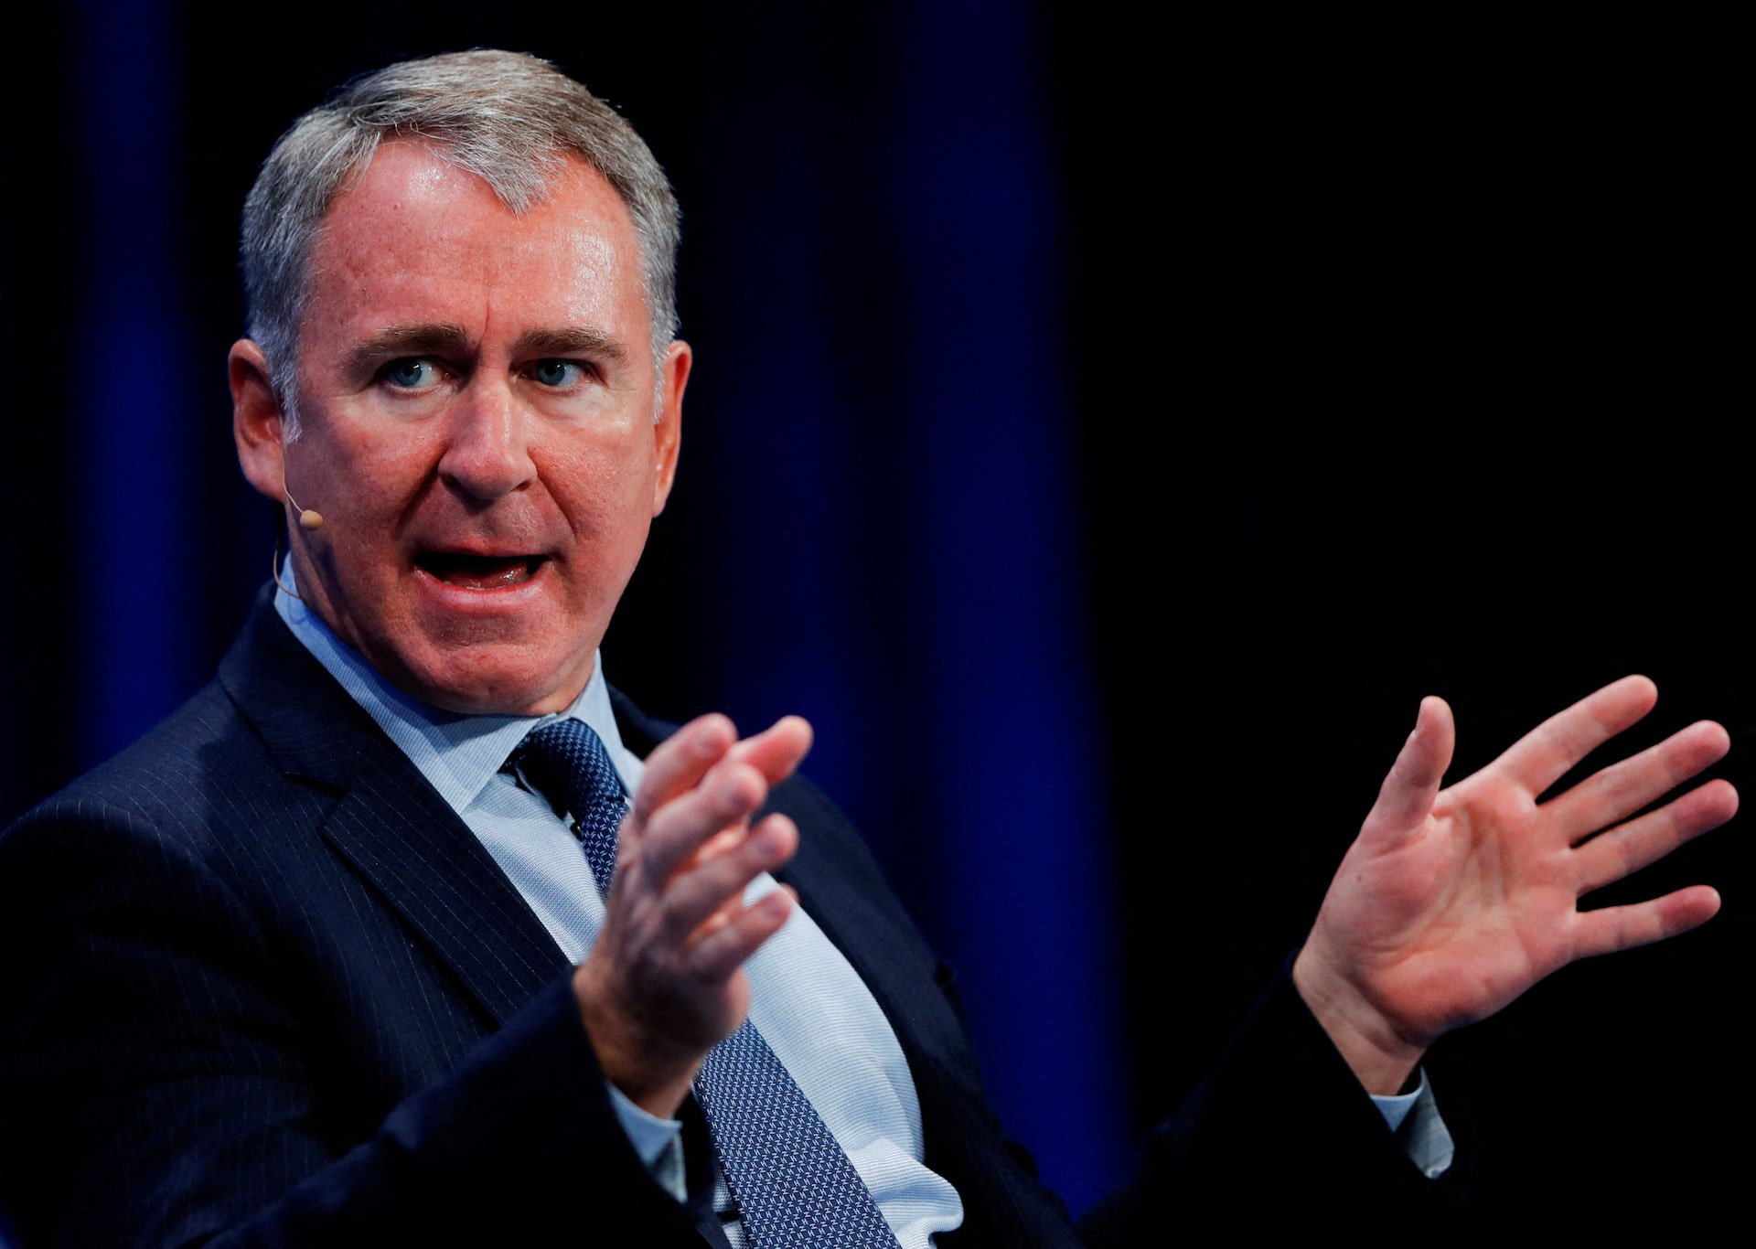
Ken Griffin and Citadel: The Buyer's Playbook
Millennium and Jane Street also bid. Citadel won the roughly $16 billion book.
Year
Firm
What Citadel did
2001
Enron
Hired its energy traders, quants and meteorologists the day after the collapse.
PHOTO
Insert image here
2006
Amaranth
Amaranth lost about $6 billion on natural gas. Citadel and JPMorgan bought the energy book at a discount.
2007
Sowood
Assembled a team overnight and delivered an offer at 3:30 in the morning.
Kenneth C. Griffin
Founder and CEO, Citadel
2021
Melvin
A rescue, not a purchase. Citadel and Point72 put in $2.75 billion. Melvin still shut down in 2022.
Started trading from a Harvard dorm in 1987.
2026
Situational Awareness
Bought the entire public book, longs and shorts, in one block trade.
Internal use only. For agent use only. Not for use with the public.
ELEVATE
NEW ORG
Notes:
PRESENTER NOTE: drop a photo of Ken Griffin into the frame on the left.
Now the other side of the trade, because somebody is always buying.
Griffin started trading convertible bonds out of his Harvard dorm in 1987 and founded Citadel in 1990 with about four and a half million dollars. Today it is arguably the most profitable hedge fund in history.
Worth noting that Millennium and Jane Street also bid for this book. Citadel won it. That tells you the assets were desirable at the right price. This was not charity and it was not a bailout.
Now the table, and this is the pattern that agents never forget once they see it.
Enron, 2001. The day after the collapse he was hiring their traders and their weather forecasters. He did not buy the company, he bought the people.
Amaranth, 2006. Lost six billion on natural gas in days. Citadel and JPMorgan bought the energy book at a steep discount.
Sowood, 2007. The story is that Citadel put a team together and delivered an offer at three thirty in the morning because everybody else had gone home.
Melvin, 2021, and get this one right because people always get it wrong. That was a rescue investment during the GameStop squeeze, not a purchase of assets. Two and three quarter billion in. Melvin shut down anyway in 2022. That one did not work.
The lesson for the room. In every forced sale there is a seller with no choice and a buyer with all the time in the world. You always want to be the second one. The way you stay the second one is by not borrowing.

Slide 45
Did Griffin Push the Fund Over the Edge?
The rumor is circulating. Here is what the evidence actually supports.
What is being claimed
What the record shows
That Citadel, or people close to it, helped spread the story of the fund's distress in order to buy the book cheaper.
The claim spread mostly through memes on X noting Griffin's reputation for pouncing when rivals stumble.
It echoes the 2021 theory that Griffin pressured Robinhood to restrict GameStop buying to protect Melvin Capital.
No reporting from CNBC, the Wall Street Journal, Bloomberg or the FT alleges Citadel caused or accelerated the collapse.
The margin calls came from the prime brokers, Goldman Sachs, JPMorgan and Bank of America. Citadel was not the lender.
On GameStop, Griffin testified under oath that Citadel did not direct Robinhood's restrictions. Those came from clearinghouse collateral demands, and later reviews found no evidence of collusion.
Verdict: unsupported. Do not repeat it to clients as fact.
Internal use only. For agent use only. Not for use with the public.
ELEVATE
NEW ORG
Notes:
Handle this carefully, because somebody has seen the memes and will bring it up.
The claim is that Griffin or people around him helped push this fund over the edge through the media so Citadel could buy the book cheap.
Here is what I could actually verify.
None of the serious reporting says that. Not CNBC, not the Journal, not Bloomberg, not the Financial Times. The margin calls came from the prime brokers. Goldman, JPMorgan and Bank of America. Citadel was not the lender and had no ability to call those loans.
The GameStop comparison is worth addressing because it is the same shape of accusation. In 2021 the theory was that Griffin leaned on Robinhood to stop people buying GameStop to protect Melvin. Griffin testified under oath before Congress that he did not. The restrictions came from the clearinghouse demanding more collateral overnight. Later reviews found no evidence of collusion.
There is one related item worth mentioning honestly. Microsoft rose more than fifteen percent on July thirtieth, its largest one day market value gain in history, on a quarter that beat revenue by under three percent. Some people look at that and see forced short covering in the tape. Others point out that Azure crossed a hundred billion dollars and growth accelerated to forty three percent, which is a real catalyst. Both things can be true. Nobody has proven the first.
So the honest answer. The rumor is unsupported. Citadel benefited enormously from this situation, and benefiting from a disaster is not the same as causing one.
Saying that to a client makes you the person in their life who checks things before repeating them. That is worth more than being first with a juicy story.

Slide 46
What to Take From This, and What to Do
Six lessons, and three conversations to book before Wednesday.
1
Right about the trend, wrong about the investment
4
The toll booth beats the track
He called the AI build-out correctly and still lost $30 billion. The question is always who gets paid.
1873, 2002, and now. The businesses that ride on the network keep the profit.
2
Leverage decides how fast, not whether
5
A hedge that shares your risk is not a hedge
Borrowed money removed his ability to wait. With no leverage he has a bad month instead of a catastrophe.
Puts on big semiconductors did not protect small high beta names. Both were the same bet.
3
Concentration is not conviction
6
Forced selling sets prices, and then it stops
Seventy six percent in five names that all moved together. Six days before the end he was asking for more money.
His holdings jumped 18% to 28% the day he finished selling. Panic on the way down locks in the loss.
Next 72 hours: find three clients concentrated in one stock or sector, find anyone borrowing to invest, and book a review with each.
Internal training only. Not investment advice and not a recommendation on any security. Sources: CNBC, WSJ, Bloomberg, FT, Porter Stansberry, SpotGamma, Yardeni Research, Bain, Moody's, NYLIM.
Internal use only. For agent use only. Not for use with the public.
ELEVATE
NEW ORG
Notes:
Close it out. Do not let them leave with a fun story and no action.
Six lessons. The first one is the one that is new, and it is the most valuable thing in this deck.
He was right about the trend and still lost thirty billion dollars. Right about AI, wrong about who gets paid for it. When a client tells you he is buying something because a technology is going to change the world, that is the sentence to give him back.
Two, leverage decided how fast, not whether. Without borrowed money this is a bad month, not the end.
Three, concentration is not conviction. Remember he was asking investors for more money six days before he lost the portfolio, and he meant it.
Four, the toll booth beats the track. 1873, 2002, and now.
Five, a hedge that shares your risk is not a hedge.
Six, forced selling sets prices and then it stops. His holdings jumped eighteen to twenty eight percent the day he finished selling.
Now the homework, and be specific about it. Find three clients who are concentrated. Too much company stock, too much in one sector, too much riding on the employer who also signs the paycheck. Find anybody who has mentioned borrowing to invest, whether that is a margin account, a home equity line, or a loan against a policy. Book one review with each.
And when you sit down, open with what has changed in their life, not with the market. The market is the excuse for the call. Their life is the reason for the meeting.
Last thing, and say it out loud. This is a training deck. It is internal, it is not investment advice, and it is not a recommendation on any security we named today.
Discussion question if you have time. Which client of yours is running a small version of this right now, and are you going to call them this week?

